Slide 1
Cross-Site Scripting
Web Vulnerabilities Day 2

Slide 2
Today’s Objectives
By the end of class, you will be able to:
Articulate common malicious uses of JavaScript
Explain how reflected and persistent XSS are delivered
Manually identify and exploit XSS vulnerabilities
Construct “syntax-breaking” XSS payloads

Slide 3
Today, we’ll look at how attackers construct and deliver XSS payloads.

Slide 4
JavaScript Deep-Dive

Slide 5
The Raw and the Rendered
Raw Markup:
<section>
<h3 id=“heading”>Meaningless Text</h3>
<p>This paragraph has some text.</p>
<p>This paragraph has more text.</p>
</section>
Browsers interpret markup by reading HTML, and then rendering it according to internal rules and CSS styles.
Rendered:
Meaningless Test
This paragraph has some text.
This paragraph has some text.

Slide 6
The DOM
Document Object Model
Browsers begin loading pages by reading their HTML.
As they do, they keep detailed records of:
which tags appear on the page, and the values of their attributes,
which elements each tag is related to
section
p
h3
p
textContent
textContent
textContent
This paragraph has some text.
Meaningless Text
This paragraph has some text.
id
heading
Notes:
After a browser finishes reading the HTML and building its record of the DOM, it renders the page.
After this, we can use JavaScript to update the browser’s internal “record” of the page (i.e., the DOM).
When the browser detects a change in the DOM, it automatically updates

Slide 7
Manipulating Elements
1. JavaScript
const heading = document.querySelector(‘#heading’)
console.log(heading.textContent) // “Meaningless Text”
heading.textContent = “Meaningful Nonsense”
Selects the element on the page with `id=heading`.
Prints out the element’s text (“Meaningless Text”)
Changes the text inside the element to “Meaningful Nonsense”
2. DOM
Meaningless Text
Meaningful Nonsense
section
h3
textContent
3. Rendered
Meaningful Nonsense
This paragraph has some text.
This paragraph has some text.
3. Rendered
Notes:
This code changes the DOM. In particular, it updates the record for our heading such that it contains the text “Meaningful Nonsense”, instead of “Meaningless Text.”
After the browser realizes the DOM has been updated, it repaints the page to reflect the changes.

Slide 8
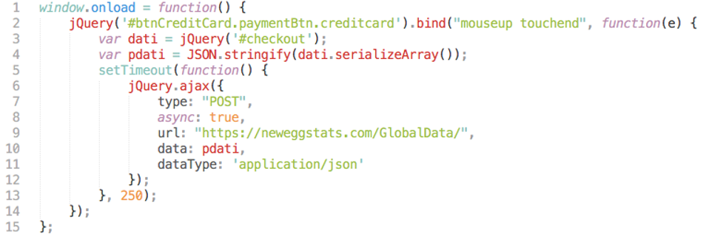
Exploit Opportunities
In the below code, an attacker has selected the element with id #btnCreditCard.
Instead of repainting a pretty menu, this code sends the user’s credit card number to the hacker’s servers as they type it.

Slide 9
Cross-Scripting Scripting // XSS

Slide 10
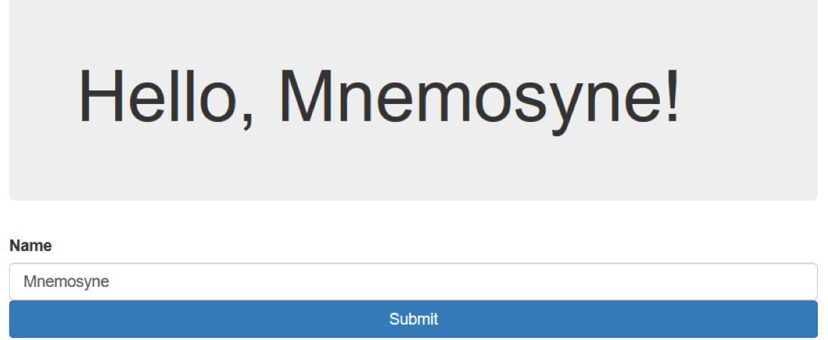
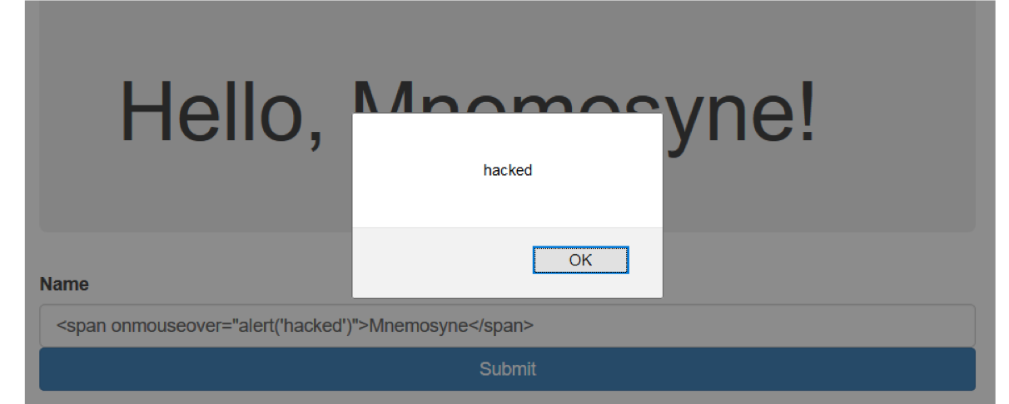
Interactivity at the cost of Vulnerability
JavaScript is often used to update HTML based on user input, but attackers can use input to submit malicious XSS payloads.
Attackers can submit malicious HTML instead of “expected” input, causing the web application to behave in unexpected ways.
In this example, a user added an HTML element that causes JavaScript to execute when the user passes their mouse over the name Mnemosyne.

Slide 11

XSS is a threat anywhere that user input is inserted into an HTML document.
The three main flavors are:
Reflected: User input echoed to page from a request.
Persistent: Malicious script is loaded from database.
Dom-Based: Exploitation of a client-side script via manipulation of the DOM.
In Reflected and Persistent, the payload is contained in the server’s response. We’ll focus on these two today.

Slide 12
Reflected XSS

Slide 13
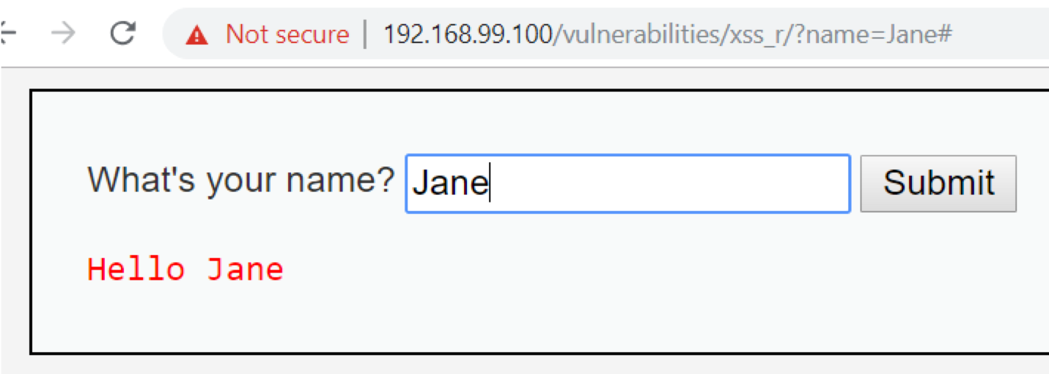
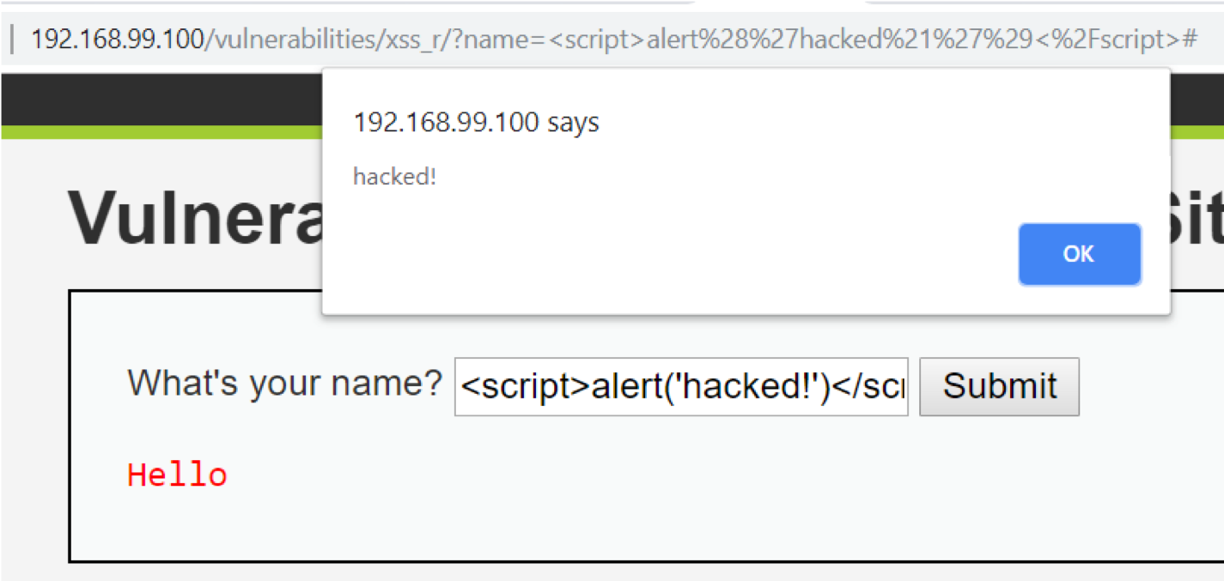
Reflection
Web apps can send user input
to the server via query params.
These params are then used
to generate the HTML response.
XSS results when the server includes
malicious JavaScript in its response.

Slide 14




Poisoned Leakes
Reflected XSS attacks are typically delivered by poisoning the query string, then phishing victims with the poisoned link.
1
Attacker sends script-injected link to victim (e.g. email scam).
Attacker
2
10101001100101010110101001111010100101010100100101010001010100010100111010100110010001100101001
Victim clicks on link and requests legitimate website.
Malicious script sends victims private data to attacker.
4
3
Victim’s browser loads legitimate site, but also executes malicious script.

Slide 15
Reflected XSS
https://xss-game.appspot.com/level1

Slide 16
Activity: Reflected XSS
In this activity, you will use DVWA and Gruyere to explore reflected XSS vulnerabilities.
Instructions sent via Slack.
20 Minutes

Slide 17
Reflected XSS

Slide 18
Persistent XSS & Attribute Attacks

Slide 19
Persistent XSS
Persistent XSS attacks occur when a server saves a malicious payload to a database.
With Persistent XSS, the payload is a threat to anyone who loads the data.
If an attacker submits a malicious script as a forum comment, anyone who loads the comments becomes a target.
Often, XSS is delivered through special attributes instead of script tags.
Certain HTML attributes can execute JavaScript:
<img src=”bad link” onerror=“alert(‘hacked!’)”>

Slide 20
Attributes Attacks
https://xss-game.appspot.com/level2

Slide 21
Activity: Persistent XSS and Attribute Attacks
In this activity, you will craft and deliver XSS payloads via HTML attributes.
Instructions sent via Slack.
20 Minutes

Slide 22
Breaking Quotes

Slide 23
Breaking Quotes
The third major injection technique is called breaking quotes.
In HTML, quotation, marks are used to provide values of attributes.
Anything within quotes is interpreted as the value of an attribute. However, anything outside of quotes is interpreted as HTML.
Whenever you can set the value of an attribute via user input, you can potentially inject HTML by inserting a quotation mark.
Next, we’ll take a look with an Demonstration.

Slide 24
Breaking Quotes
https://xss-game.appspot.com/level3

Slide 25
Activity: Breaking Quotes
In this activity, you will use Gruyere to practice the technique of “Breaking Quotes”.
Instructions sent via Slack.
20 Minutes

Slide 26
Breaking Quotes

Slide 27
Today’s Objectives
By the end of class, you will be able to:
Articulate common malicious uses of JavaScript
Explain how reflected and persistent XSS are delivered
Manually identify and exploit XSS vulnerabilities
Construct “syntax-breaking” XSS payloads

